Slide 1
Chapter IV – Statistical Tests

Slide 2
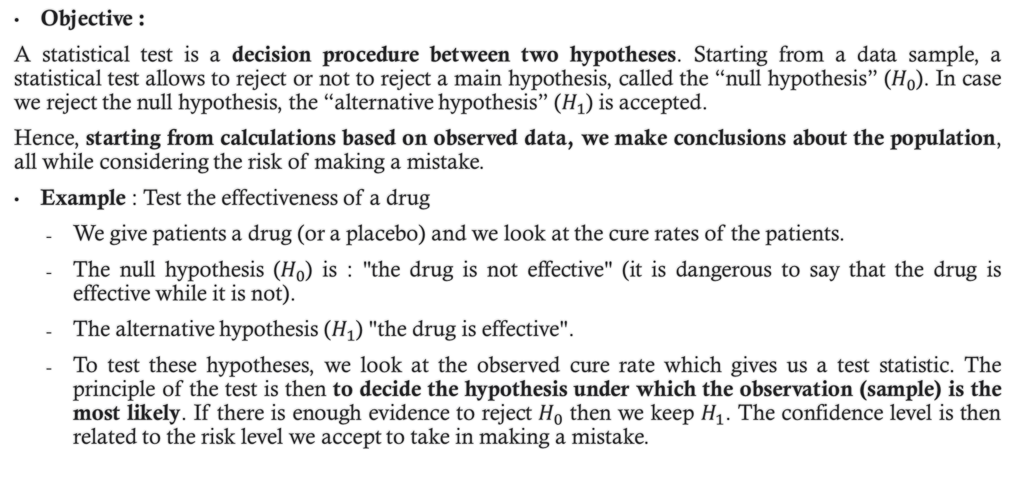
1. Introduction
Objective :
A statistical test is a decision procedure between two hypotheses. Starting from a data sample, a statistical test allows to reject or not to reject a main hypothesis, called the “null hypothesis” ($H_{0}$). In case we reject the null hypothesis, the “alternative hypothesis” ($H_{1}$) is accepted.
Hence, starting from calculations based on observed data, we make conclusions about the population, all while considering the risk of making a mistake.
Example : Test the effectiveness of a drug
We give patients a drug (or a placebo) and we look at the cure rates of the patients.
The null hypothesis ($H_{0}$) is : "the drug is not effective" (it is dangerous to say that the drug is effective while it is not).
The alternative hypothesis ($H_{1}$) "the drug is effective".
To test these hypotheses, we look at the observed cure rate which gives us a test statistic. The principle of the test is then to decide the hypothesis under which the observation (sample) is the most likely. If there is enough evidence to reject $H_{0}$ then we keep $H_{1}$. The confidence level is then related to the risk level we accept to take in making a mistake.

Slide 3
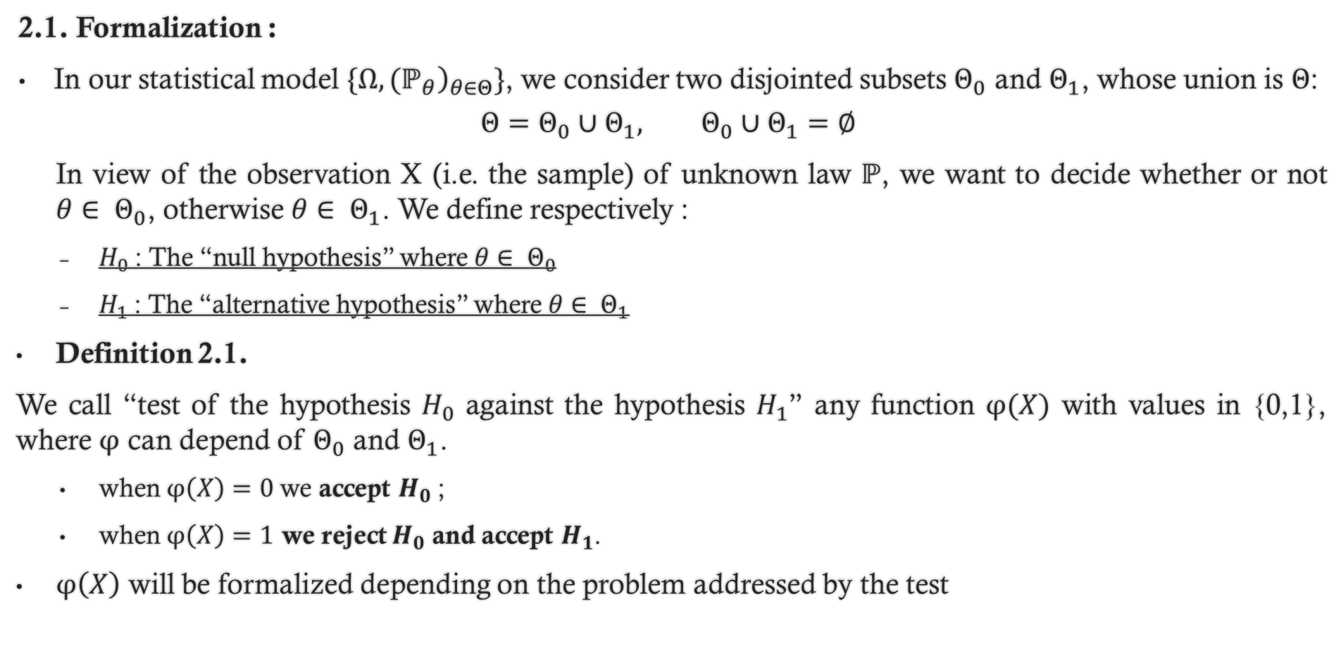
2. Construction of statistical tests
2.1. Formalization :
In our statistical model ${\{\left.Ω, {(ℙ}_{θ}\right)}_{θ∈Θ}\}$, we consider two disjointed subsets $Θ_{0}$ and $Θ_{1}$, whose union is $Θ$:
$$Θ=Θ_{0}∪Θ_{1}, Θ_{0}∪Θ_{1}=∅$$
In view of the observation X (i.e. the sample) of unknown law $ℙ$, we want to decide whether or not $θ∈ Θ_{0}$, otherwise $θ∈ Θ_{1}$. We define respectively :
$H_{0}$: The “null hypothesis” where $θ∈ Θ_{0}$
$H_{1}$: The “alternative hypothesis” where $θ∈ Θ_{1}$
Definition 2.1.
We call “test of the hypothesis $H_{0}$ against the hypothesis $H_{1}$” any function $φ(X)$ with values in {0,1}, where $φ$ can depend of $Θ_{0}$ and $Θ_{1}$.
when $φ\left(X\right)=0$we accept $H_{0}$;
when $φ\left(X\right)=1$ we reject $H_{0}$ and accept $H_{1}$.
$φ\left(X\right)$ will be formalized depending on the problem addressed by the test

Slide 4
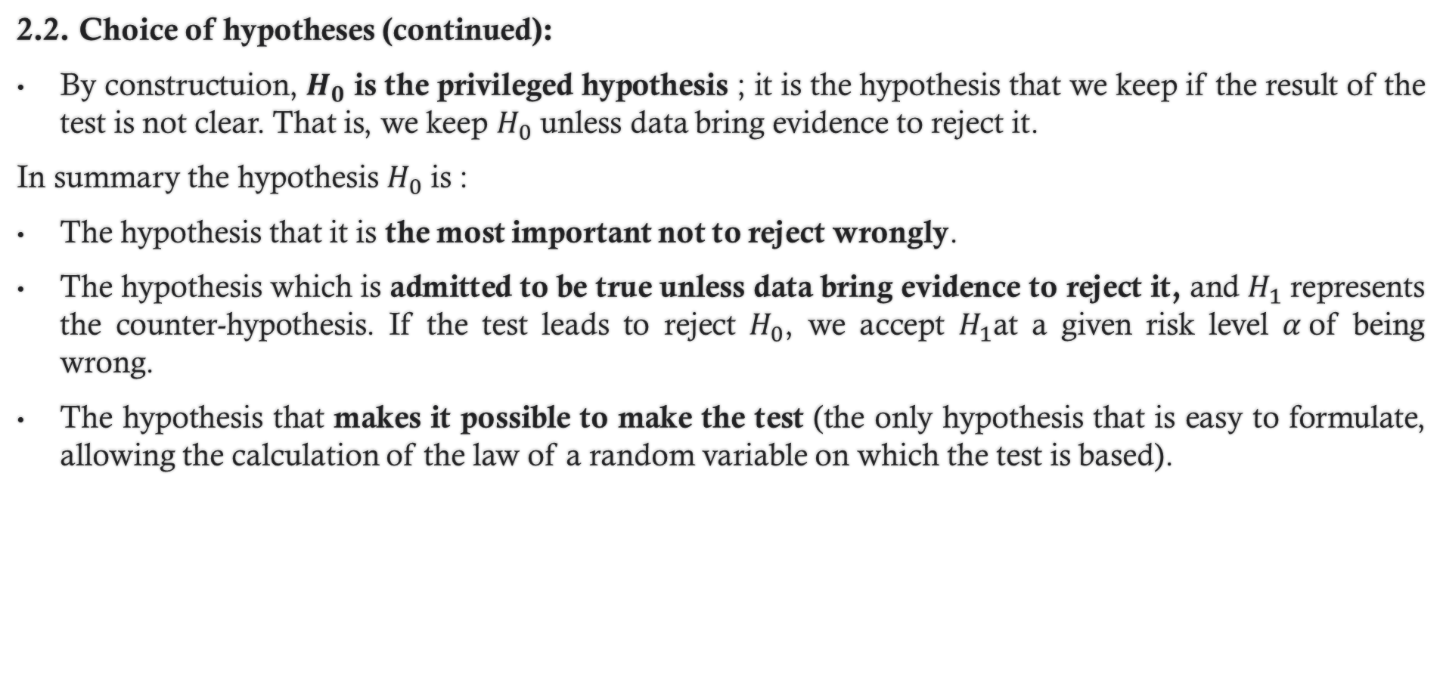
2. Construction of statistical tests
2.2. Choice of hypotheses (continued):
By constructuion, $H_{0}$ is the privileged hypothesis ; it is the hypothesis that we keep if the result of the test is not clear. That is, we keep $H_{0}$ unless data bring evidence to reject it.
In summary the hypothesis $H_{0}$ is :
The hypothesis that it is the most important not to reject wrongly.
The hypothesis which is admitted to be true unless data bring evidence to reject it, and $H_{1}$ represents the counter-hypothesis. If the test leads to reject $H_{0}$, we accept $H_{1}$at a given risk level $α$of being wrong.
The hypothesis that makes it possible to make the test (the only hypothesis that is easy to formulate, allowing the calculation of the law of a random variable on which the test is based).

Slide 5
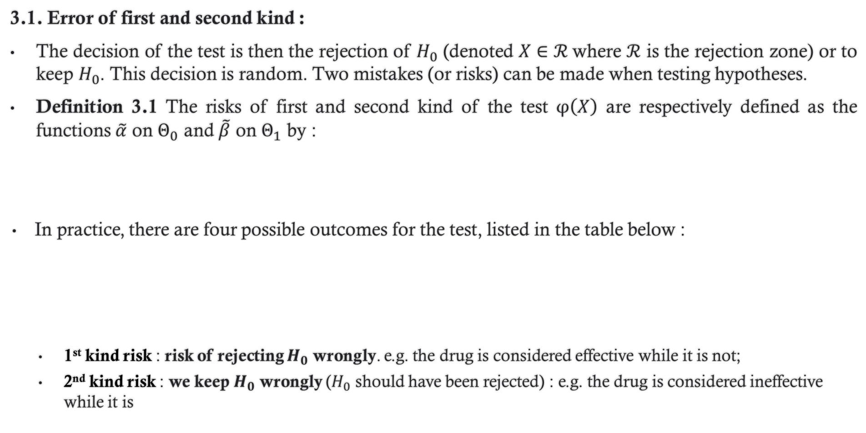
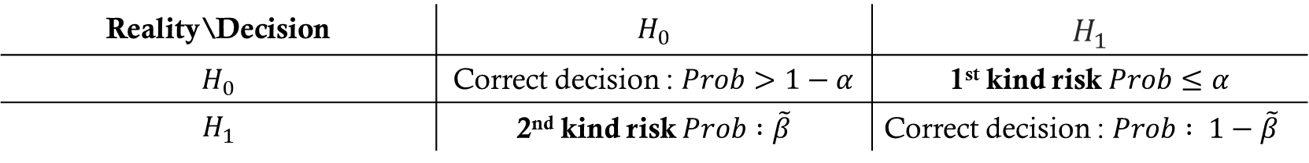
3. Characteristics of a test :
3.1. Error of first and second kind :
The decision of the test is then the rejection of $H_{0}$ (denoted $X∈ℛ$where $ℛ$ is the rejection zone) or to keep $H_{0}$. This decision is random. Two mistakes (or risks) can be made when testing hypotheses.
Definition 3.1 The risks of first and second kind of the test $φ\left(X\right)$ are respectively defined as the functions $\tilde{α}$ on $Θ_{0}$ and $\tilde{β}$ on $Θ_{1}$ by :
In practice, there are four possible outcomes for the test, listed in the table below :
1st kind risk : risk of rejecting $H_{0}$ wrongly. e.g. the drug is considered effective while it is not;
2nd kind risk : we keep $H_{0}$ wrongly ($H_{0}$ should have been rejected) : e.g. the drug is considered ineffective while it is
$$\tilde{α}: Θ_{0}⟶\left[0,1\right] \\ θ↦ℙ_{θ}\left(φ\left(X\right)=1\right)$$ | $$\tilde{β}: Θ_{1}⟶\left[0,1\right] \\ θ↦ℙ_{θ}\left(φ\left(X\right)=0\right)$$
Reality\Decision | $$H_{0}$$ | $$H_{1}$$
$$H_{0}$$ | Correct decision : $Prob>1−α$ | 1st kind risk $Prob≤α$
$$H_{1}$$ | 2nd kind risk $Prob :\tilde{β}$ | Correct decision : $Prob : 1−\tilde{β}$

Slide 6
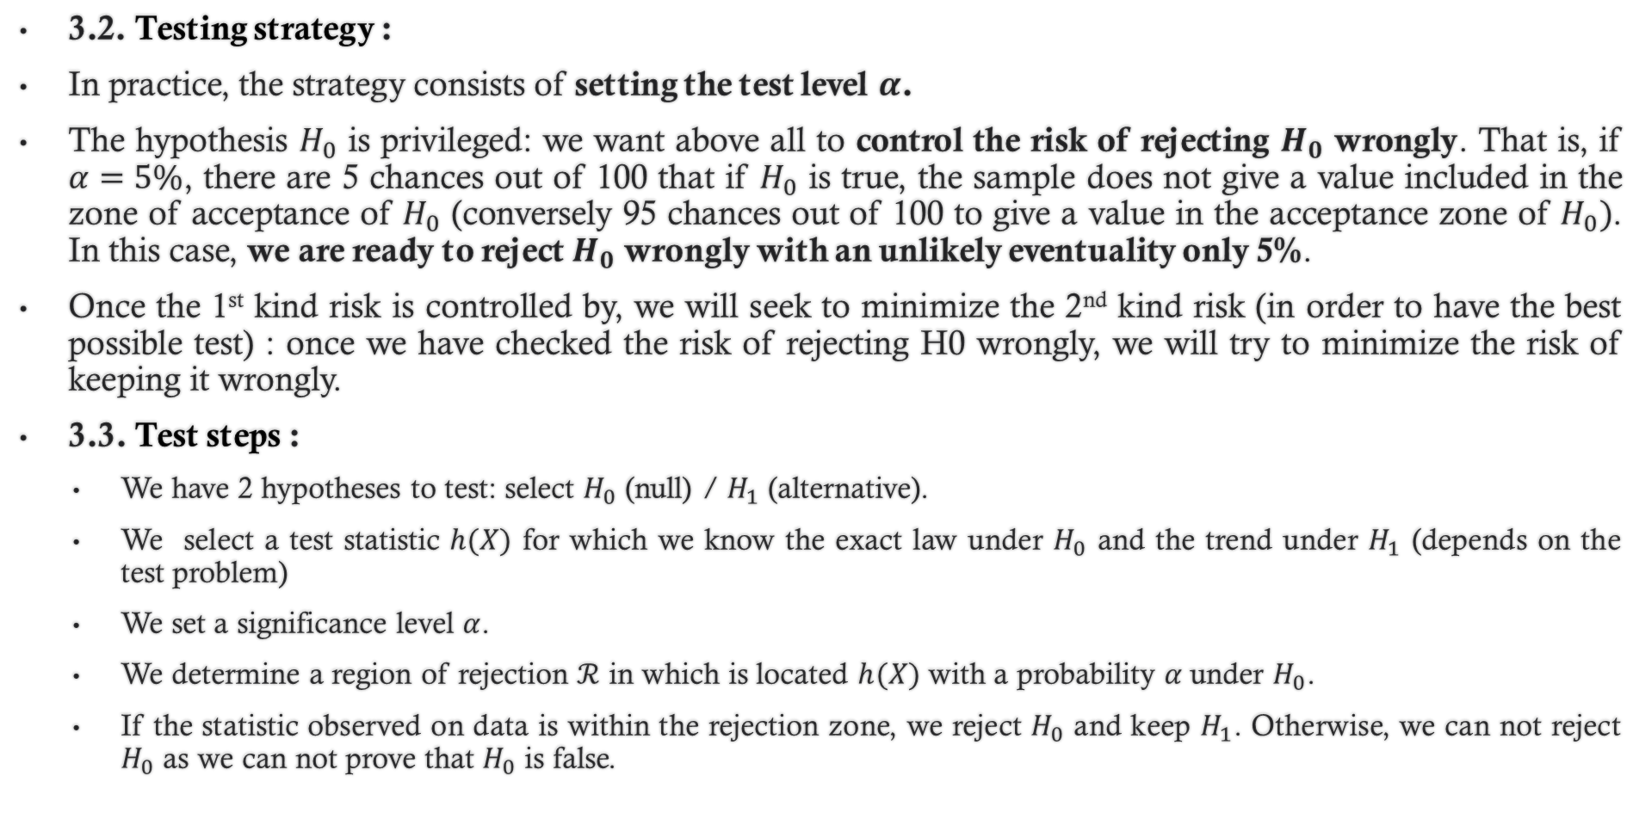
3. Characteristics of a test :
3.2. Testing strategy :
In practice, the strategy consists of setting the test level $α$.
The hypothesis $H_{0}$ is privileged: we want above all to control the risk of rejecting $H_{0}$ wrongly. That is, if $α=5\%$, there are 5 chances out of 100 that if $H_{0}$ is true, the sample does not give a value included in the zone of acceptance of $H_{0}$ (conversely 95 chances out of 100 to give a value in the acceptance zone of $H_{0})$. In this case, we are ready to reject $H_{0}$ wrongly with an unlikely eventuality only 5%.
Once the 1st kind risk is controlled by, we will seek to minimize the 2nd kind risk (in order to have the best possible test) : once we have checked the risk of rejecting H0 wrongly, we will try to minimize the risk of keeping it wrongly.
3.3. Test steps :
We have 2 hypotheses to test: select $H_{0}$ (null) / $H_{1}$ (alternative).
We select a test statistic $h(X)$ for which we know the exact law under $H_{0}$ and the trend under $H_{1}$ (depends on the test problem)
We set a significance level $α$.
We determine a region of rejection $ℛ$ in which is located $h(X)$ with a probability $α$under $H_{0}$.
If the statistic observed on data is within the rejection zone, we reject $H_{0}$ and keep $H_{1}$. Otherwise, we can not reject $H_{0}$ as we can not prove that $H_{0}$ is false.

Slide 7
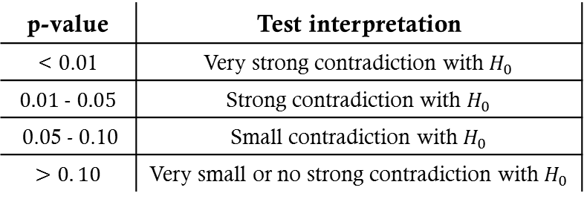
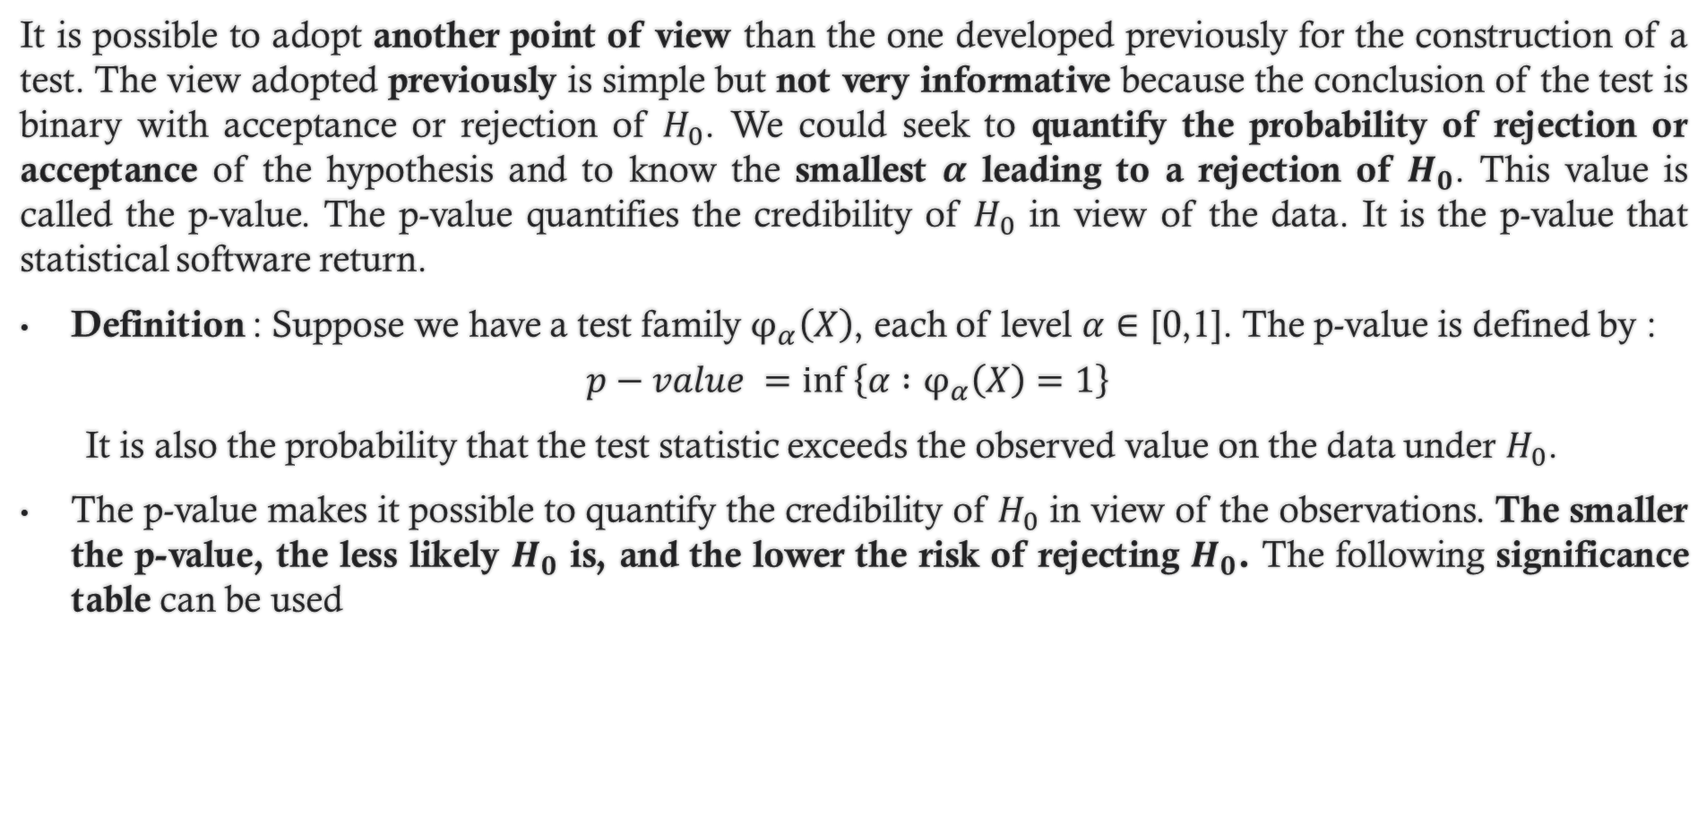
4. p-value :
It is possible to adopt another point of view than the one developed previously for the construction of a test. The view adopted previously is simple but not very informative because the conclusion of the test is binary with acceptance or rejection of $H_{0}$. We could seek to quantify the probability of rejection or acceptance of the hypothesis and to know the smallest $α$ leading to a rejection of $H_{0}$. This value is called the p-value. The p-value quantifies the credibility of $H_{0}$ in view of the data. It is the p-value that statistical software return.
Definition : Suppose we have a test family $φ_{α}\left(X\right)$, each of level $α∈\text{[0}\text{,}\text{1]}$. The p-value is defined by :
$$p−value =inf \left\{α :φ_{α}\left(X\right)=1\right\}⁡$$
It is also the probability that the test statistic exceeds the observed value on the data under $H_{0}$.
The p-value makes it possible to quantify the credibility of $H_{0}$ in view of the observations. The smaller the p-value, the less likely $H_{0}$ is, and the lower the risk of rejecting $H_{0}$. The following significance table can be used
p-value | Test interpretation
$$\text{< 0.01}$$ | Very strong contradiction with $H_{0}$
$$0.01 − 0.05$$ | Strong contradiction with $H_{0}$
0.05 - 0.10 | Small contradiction with $H_{0}$
$$>0. 10$$ | Very small or no strong contradiction with $H_{0}$

Slide 8
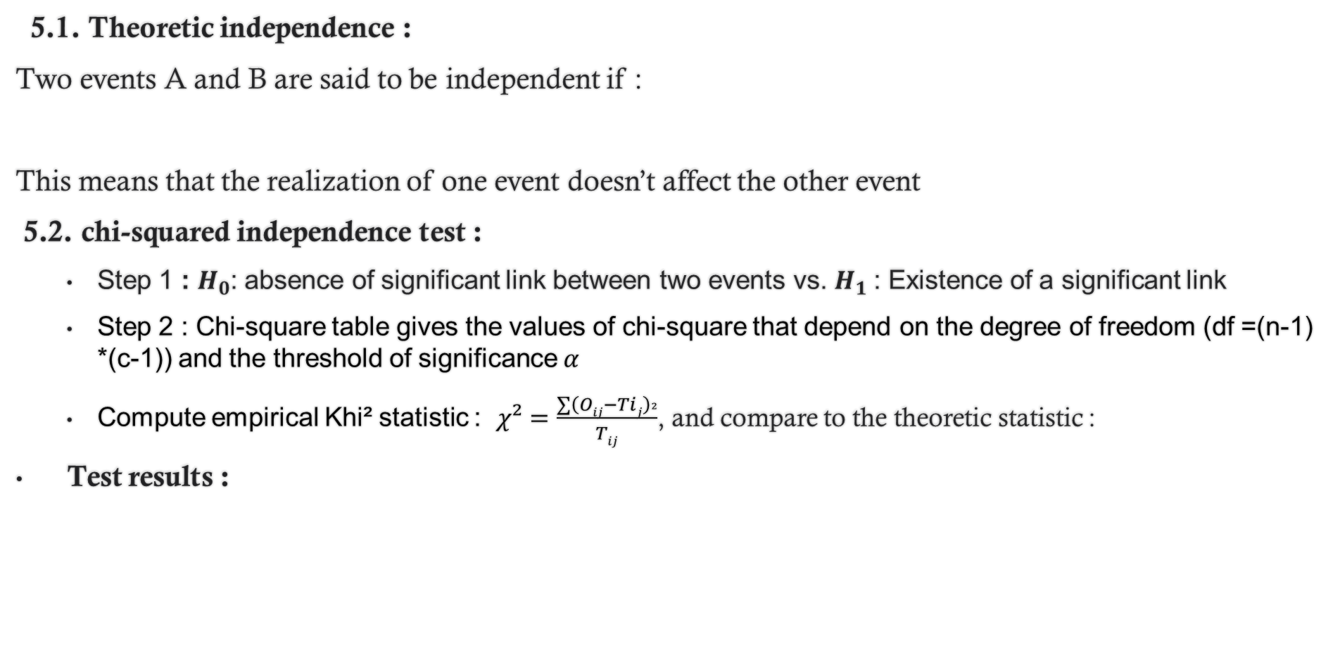
5. Application : chi-squared $(χ^{2})$ independence test
5.1. Theoretic independence :
Two events A and B are said to be independent if :
This means that the realization of one event doesn’t affect the other event
5.2. chi-squared independence test :
Step 1 : $H_{0}$: absence of significant link between two events vs. $H_{1}$: Existence of a significant link
Step 2 : Chi-square table gives the values of chi-square that depend on the degree of freedom (df =(n-1) *(c-1)) and the threshold of significance $α$
Compute empirical Khi² statistic : $χ²=\frac{∑{\left(Oij−Tij\right)}^{2}}{Tij}$, and compare to the theoretic statistic :
Test results :
Non-rejection of H0
Rejection of H0

